Slide 1
Build your first QML Interface
Aakarsh MJ

Slide 2
Introduction
Declarative language
Inline Javascript to handle imperative aspects
Component Based Architecture
Property Bindings
Cross Platform Compatibility
Adaptive UI for any screen size

Slide 3




Some Popular Qt/QML applications

Slide 4
Demo - Requirements

Slide 5
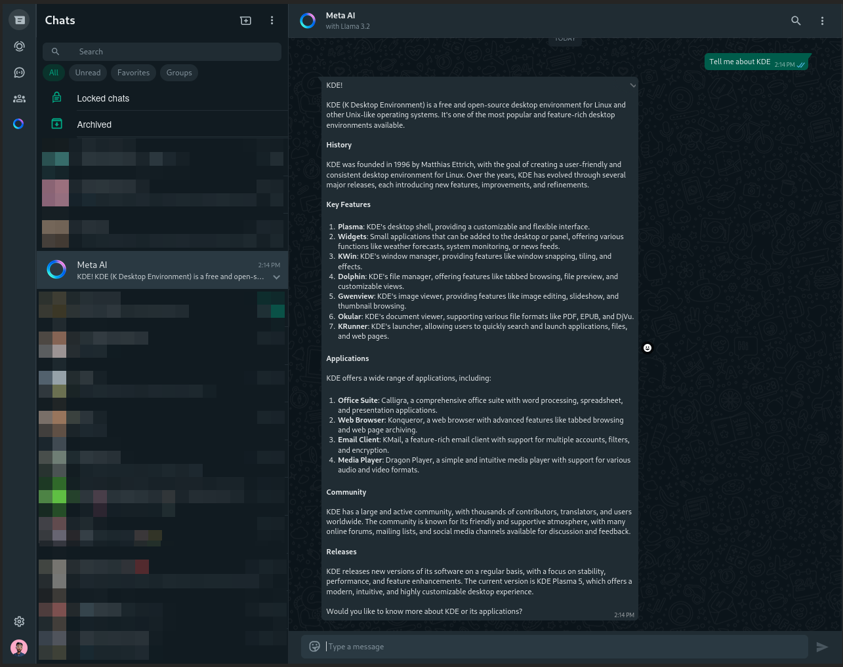
Whatsapp UI (Referrence)

Slide 6

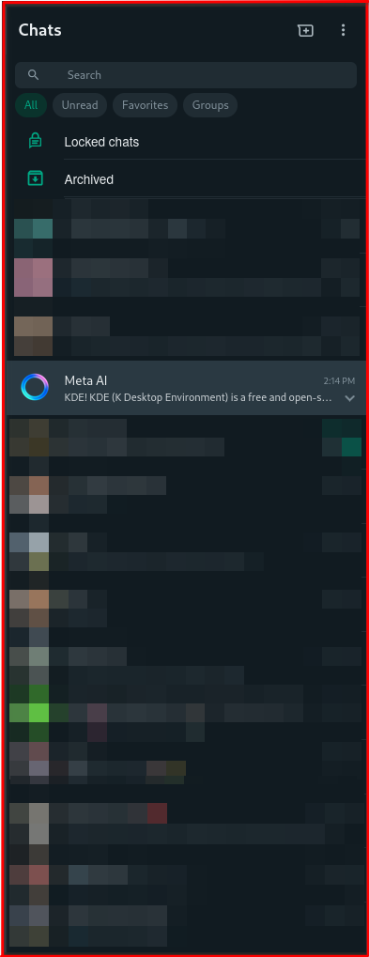
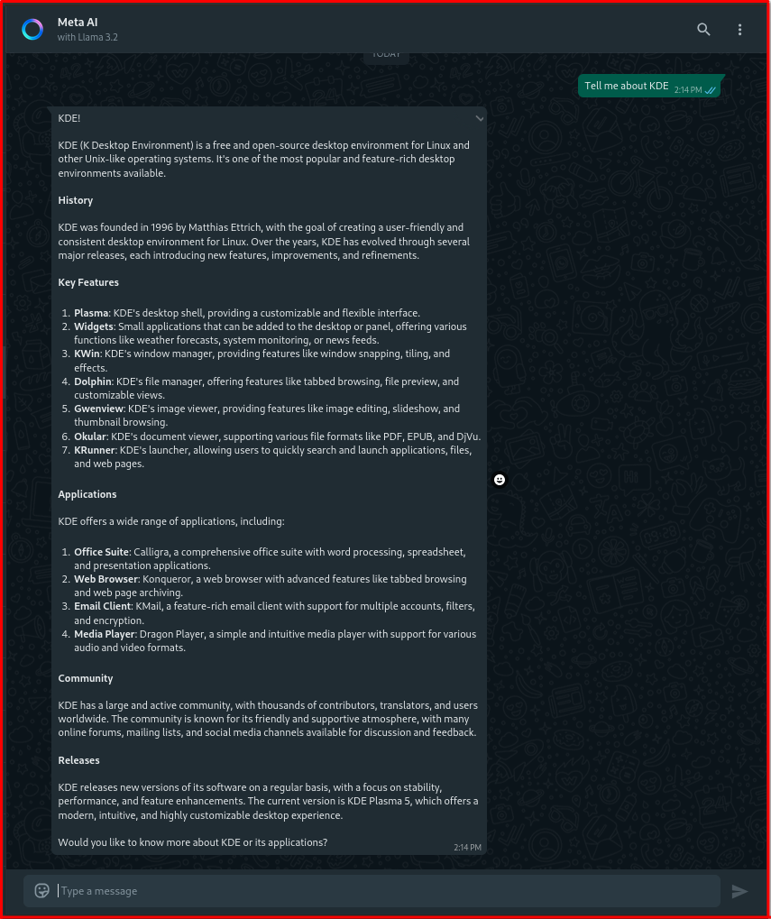

Slide 7
Sidebar

